Slide 1
Notes:
Presentation description: Looks at different approaches to building a retirement income strategy.

Slide 2
Building Retirement Income Strategies
Making It Last – Retirement Income for Everyday Investors
Notes:
Let’s discuss some approaches to building a retirement income strategy.

Slide 3
Agenda
A Retirement Income Reality Check
Multi-Asset Plus Reserve Strategy
Time-Based Bucket Strategy
Notes:
First, I’d like to do a quick retirement income reality check. We’ll discuss some outdated retirement income ideas and why they may not be the best options today.
Next, I’ll introduce a multi-asset plus reserve strategy to generate retirement income.
Last, we’ll look at how a time-based bucket strategy works.
Let’s get started.

Slide 4
A Retirement Income Reality Check
Money Market Yield on a $100,000 Investment
1981 = 16.4%
$16,400
2020 = 0.36%
$360
This chart is for illustrative purposes only and does not reflect the performance of any Franklin Templeton fund.
Source: Lipper for Investment Management. Based on the average annualized 12-month yield paid by Money Market Funds tracked by Lipper in 1981 and 2020.
Notes:
Probably the most basic retirement income strategy is to invest your savings into something that generates interest payments and then live off whatever interest income you receive.
Years ago, this may have worked well. In 1981, $100,000 invested in a money market fund generated more than $16,000 a year.
[CLICK] That would have been enough money to buy a brand new 1981 Cadillac DeVille and still have some money left over.
[CLICK] Today, the exact same investment generates less than $500 a year. Perhaps enough to buy a brand new...
[CLICK] …electric scooter? Not quite as appealing.
This is true for many income-oriented investments today. They just don’t pay enough income to live on.

Slide 5
Stocks Have Delivered Strong Historical Returns
But the Ride is Often Bumpy
S&P 500 Index Average Annual Total Returns (1990–2020)
The average annual total return of the S&P 500 Index from 1926-2020 was:
10.29%
2020
This chart is for illustrative purposes only and does not reflect the performance of any Franklin Templeton fund.
Past performance does not guarantee future results.
Source: © 2021 Morningstar, Inc. Indexes are unmanaged and one cannot invest directly in an index. Index returns do not reflect any fees, expenses or sales charges.
Notes:
If living off interest payments is not a viable strategy, you might think about investing in the stock market. After all, stocks have had strong historical returns.
[CLICK] In fact, over the long-term stocks have delivered an average annual return of more than 10%.
Why not invest in stocks, earn that 10% and take out the gains each year while keeping the original investment untouched?
[CLICK] That 10% historical return is an average, and not guaranteed each year. This chart shows that in the last 30 years, stocks failed to hit the average return 12 times.
More critical are the years in which stocks had negative returns. The combination of withdrawals and declining markets can be very damaging to your retirement savings.
Building an effective retirement income strategy that can both generate the required income needed and withstand market ups and downs may require a more diversified, strategic approach.
Let’s walk through a couple of examples.

Slide 6
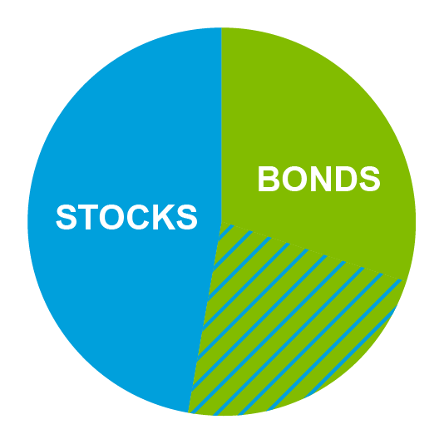
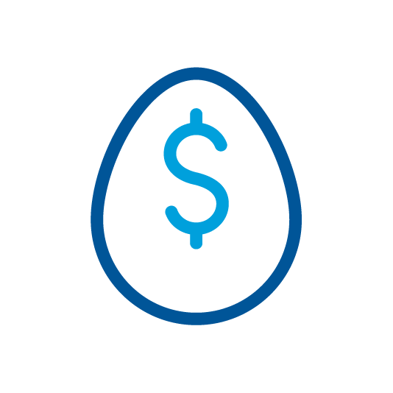
Multi-Asset Plus Reserve Strategy
Multi-Asset
growth and income investments
Reserve
2-3 years of cash/fixed income investments
Retirement Assets
Notes:
The first strategy I’d like to share is called a multi-asset plus reserve strategy.
[CLICK] In this approach, retirement assets are split into two portfolios.
One is a multi-asset portfolio, which simply means it is set up to invest in a mix of stocks and bonds.
It will hold the majority of the retirement savings and the allocation to stocks and bonds can vary depending on the person’s situation and risk tolerance.
The second is a reserve portfolio that is designed to hold enough to cover retirement income needs for two to three years. It will be invested very conservatively.
Let’s see how this strategy works in different hypothetical markets, starting with an up market.

Slide 7
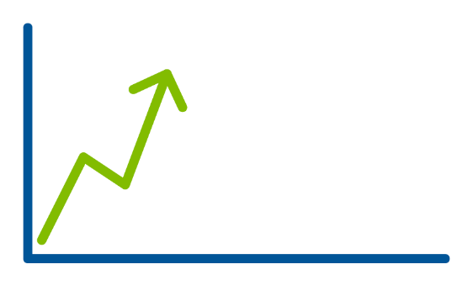
Multi-Asset Plus Reserve Strategy
Multi-Asset
growth and income investments
Reserve
2-3 years of cash/fixed income investments
UP Market
Notes:
In a rising market the multi-asset portfolio may grow, depending the underlying investments and the mix of stocks and bonds.
[CLICK] When this occurs, money will be withdrawn from this portfolio to support annual retirement expenses.
Of course, markets don’t always go up, sometimes they go down.

Slide 8
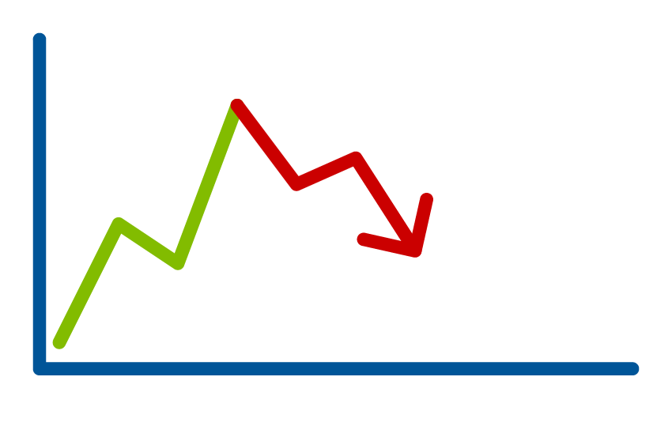
Multi-Asset Plus Reserve Strategy
Multi-Asset
growth and income investments
Reserve
2-3 years of cash/fixed income investments
DON’T USE
DOWN Market
Notes:
When the market contracts, it’s expected the multi-asset portfolio will lose some value as well, depending on the underlying investments and the mix of stocks and bonds.
[CLICK] During these down years, you don’t want to use the multi-asset portfolio to support your retirement expenses.
The goal is to avoid withdrawing money while the portfolio is down. Doing so would be the equivalent of selling low.
[CLICK] Instead, the reserve portfolio is used to support retirement expenses during a down year.
In this strategy, the reserve portfolio, with its cash and conservative investments, functions like an emergency fund.
The hope is that using the reserve portfolio will buy some time and allow a market recovery to take hold.

Slide 9
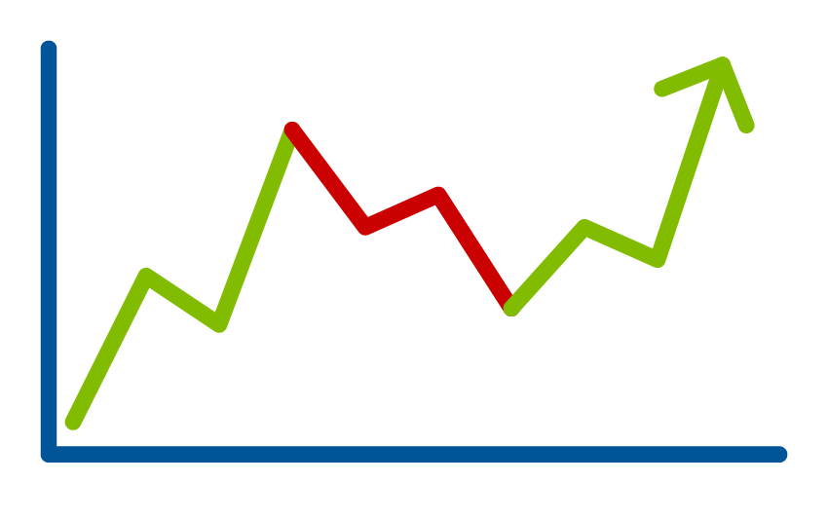
Multi-Asset Plus Reserve Strategy
Multi-Asset
growth and income investments
Reserve
2-3 years of cash/fixed income investments
Market RECOVERY
Notes:
In a market recovery, it’s expected the multi-asset portfolio will also recover.
[CLICK] When this happens you will switch back and use the multi-asset portfolio to fund retirement expenses for the year.
[CLICK] And, if the recovery is strong enough, money may also be shifted to replenish the reserve portfolio.
Now let’s look at another strategy that is sometimes referred to as the bucket strategy.

Slide 10
Time-Based Bucket Strategy
Retirement Assets
Now (1 Year)
cash investments
Soon (2-10 Years)
income investments
Later (10+ Years)
growth investments
Notes:
There are many variations of the bucket strategy, but the most common consists of three buckets which we’ll call Now, Soon, and Later.
[CLICK] Retirement assets are split into these three buckets.
The Now Bucket is the smallest and holds the money needed in the short-term, usually within the next year. It will consist of cash and very safe investments.
The Soon Bucket holds the money needed in the intermediate-term, generally over the next 2-10 years. It should be several times the size of the Now Bucket. The savings will be invested to generate income, usually in bonds, other fixed income investments, or dividend paying stocks.
Last, is the Later Bucket. It is generally the largest bucket and holds the money needed in the long-term, usually 10 or more years. It is invested for growth and typically holds stocks.
Segmenting retirement savings like this helps align investment allocations and risks with an appropriate time horizon.
Let’s look at some different hypothetical markets and how this strategy works, starting again with an up market.

Slide 11
Time-Based Bucket Strategy
UP Market
Now (1 Year)
cash investments
Soon (2-10 Years)
income investments
Later (10+ Years)
growth investments
Notes:
When the market rises, it’s expected the Soon and Later Buckets will both rise as well. The Now Bucket remains unchanged because it’s mostly cash.
[CLICK] Over the course of the year, funds are withdrawn from the Now Bucket, depleting it by the end of the year.
[CLICK] To fund the next year’s spending, the Now Bucket will be refilled from the Soon Bucket.
[CLICK] Then, the Later Bucket replenishes the Soon Bucket, bringing all three back into balance.
Now let’s look at what happens when there’s a down market.

Slide 12
Time-Based Bucket Strategy
DOWN Market
DON’T USE
Now (1 Year)
cash investments
Soon (2-10 Years)
income investments
Later (10+ Years)
growth investments
Notes:
When the market declines, it’s expected the Soon and Later Buckets, based on their investments, may also see a decline. The Now Bucket, with its cash and very safe investments, doesn’t change.
[CLICK] During the year, money is still withdrawn from the Now Bucket, emptying it by year end.
[CLICK] The Soon Bucket will again be used to replenish the Now Bucket and provide next year’s spending.
[CLICK] However, this time the Later Bucket isn’t used to replenish the Soon Bucket. It will remain untouched.
In this scenario, the Soon Bucket acts as a cushion, buying time for the Later Bucket to recover. Even after a decline, the Soon Bucket should have enough to fund retirement spending for several years, if needed.
The hope is that the market, along with the buckets, will eventually recover.

Slide 13
Time-Based Bucket Strategy
Market RECOVERY
Now (1 Year)
cash investments
Soon (2-10 Years)
income investments
Later (10+ Years)
growth investments
Notes:
In a market recovery, it’s expected the Soon and Later Buckets will rise.
[CLICK] Once again, money is taken from the Now Bucket for the current year’s needs.
[CLICK] It is replenished using the Soon Bucket.
[CLICK] And once recovered, the Later Bucket can be used to replenish the Soon Bucket.
These are just a couple of approaches you can use to build a retirement income strategy. By working with your trusted financial professional, you can explore these strategies, and many others, that may help generate the income you need from your retirement savings.

Slide 14
Benefits of a Diverse Retirement Income Strategy
Doesn’t rely solely on income yields or stock appreciation to generate retirement income
Establishes an approach to help manage market volatility
Aligns investment allocations and risks with an appropriate time horizon
Diversification and asset allocation strategies do not ensure a profit or protect against a loss.
Notes:
Let’s recap the benefits of building a diverse retirement income strategy.
One, it doesn’t rely solely on income yields or stock appreciation to generate retirement income.
Income-oriented investments don’t pay what they used to, and stocks may introduce an unacceptable level of risk to a retirement income strategy.
[CLICK] Two, a diverse strategy establishes an approach to help manage market volatility.
Markets can be unpredictable, and it helps to have a plan when they don’t behave as expected.
[CLICK] And three, building a diverse retirement income strategy helps align investment allocations and risks with an appropriate time horizon.
A financial professional can help assess your individual situation and design a customized strategy to meet your unique retirement income goals and risk tolerance.

Slide 15
Retirement is wonderful if you have two essentials — much to live on and much to live for.”
– Unknown
Notes:
In short, “Retirement is wonderful if you have two essentials—much to live on and much to live for.”
That’s why it’s important that you are here today. You’ve shown that you want to take the steps to be prepared.

Slide 16
This communication is general in nature, and should not be considered or relied upon as legal, tax or investment advice or an investment recommendation, or as a substitute for legal or tax counsel and provided for educational and informational purposes only. Any investment products or services named herein are for illustrative purposes only, and should not be considered an offer to buy or sell, or an investment recommendation for, any specific security, strategy or investment product or service. Always consult a qualified professional or your own independent financial professional for personalized advice and investment recommendations tailored to your specific goals, individual situation, and risk tolerance.
Franklin Templeton Investments does not provide legal or tax advice. Federal and state laws and regulations are complex and subject to change, which can materially impact your results. Franklin Templeton Distributors, Inc. (FTDI) cannot guarantee that such information is accurate, complete or timely; and disclaims any liability arising out of your use of, or any tax position taken in reliance on, such information.
All financial decisions, strategies, and investments involve risks, including possible loss of principal. Stock prices fluctuate, sometimes rapidly and dramatically, due to factors affecting individual companies, particular industries or sectors, or general market conditions. Bond prices generally move in the opposite direction of interest rates. Thus, as the prices of bonds in the fund adjust to a rise in interest rates, the fund’s share price may decline. Changes in the financial strength of a bond issuer or in a bond’s credit rating may affect its value.
Fluctuations in the financial markets and other factors may cause declines in one’s account. Diversification and asset allocation strategies do not ensure a profit or protect against a loss. There is no guarantee that any particular asset allocation will meet one’s investment goal, provide one with a given level of income, or provide sufficient funds to meet future retirement needs. Investors are strongly advised to consult with appropriate financial, legal or tax professionals about one’s specific circumstances and individual goals.
Important data provider notices and terms available at www.franklintempletondatasources.com.
Investors should carefully consider a fund’s investment goals, risks, charges and expenses before investing. To obtain a summary prospectus and/or prospectus, which contains this and other information, talk to your financial professional, call us at (800) DIAL BEN/342-5236 or visit franklintempleton.com. Please carefully read the prospectus before you invest or send money.
Franklin Templeton Distributors, Inc.
One Franklin Parkway
San Mateo, CA 94403-1906
franklintempleton.com
MIL3 PPT 02/21

